Slide 1
ONLY-CLOWNS
Software Pitch Deck
Connecting Honk-felt Hearts

Slide 2
Meet the team
Austin Rager, Big into skateboarding 🛹
Kiara Rojas, I can do wild whistle
Kenneth Branch, Big fan of Eevee
Sasha Bates, secretly good at Pitcross
Confidential

Slide 3

There are millions of clowns around the world
Clowns receive minimal representation on modern dating apps
No filters on dating apps for clowns such as shoe sizes, practices, etc.
The Clown-undrum
Austin Rager

Slide 4
What is OnlyClowns?
OnlyClowns is a premier dating and networking platform exclusively for professional, amateur, and aspiring clowns.
Clowns all over the world can connect converse, and find matches easily to create meaningful relationships without having the struggle of even finding them in the first place
Austin Rager

Slide 5
In-Scope
Our main goals for this project include 3 top objectives:
Objective 1 - Profile Systems
Objective 2 - Interest-Based Matching
Objective 3 - Communication
Create the ability to show other clowns who you are, your interests, and your preferences.
Allow matching and sorting of profiles, letting users sort out profiles of users they are not compatible with.
Allow chatting between matching profiles in a secure, reliable way.
Sasha Bates

Slide 6
Out of Scope
After launching basic dating features, we'll add safety reporting and premium priority accounts before eventually introducing event planning and hosting capabilities.
Event Planning/Hosting
Reporting System
Priority Accounts
Profile Systems
Interest-Based Matching
Communication
Sasha Bates

Slide 7
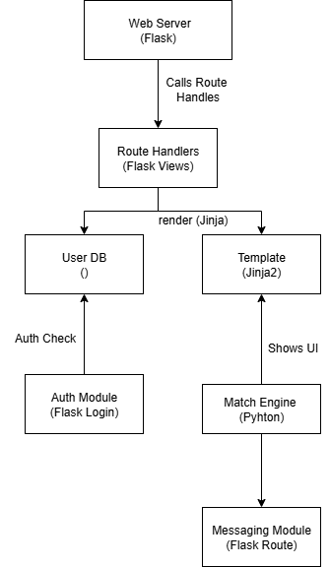
SOLUTION ARCHITECTURE
Web Server (Flask)
Flask is flexible and allows us to customize the app easily, without extra complexity.
Route Handlers (Flask Views)
When a user visits a page (like the homepage or profile page), Flask decides what data to show by calling the appropriate view function.
The route handlers also manage user interactions (e.g., sending messages.
User DB (SQL)
SQL is used to store all user data, including profiles, messages, matches, and other related information.
KIARA ROJAS

Slide 8
SOLUTION ARCHITECTURE
Template(Jinja2)
Jinja2 is the templating engine used to render dynamic HTML.
When Flask needs to render a page, it uses Jinja2 to fill in dynamic content (e.g., user name, profile pictures, messages) into pre-defined HTML templates.
Authentication Module (Flask-Login)
Flask-Login is used to manage user authentication (signing up, logging in, logging out).
Match Engine (Python)
It uses Python scripts to calculate which users are compatible and should be matched based on their interests and same profile information.
Messaging Module (Flask Route)
Enables communication between matched users.
KIARA ROJAS

Slide 9
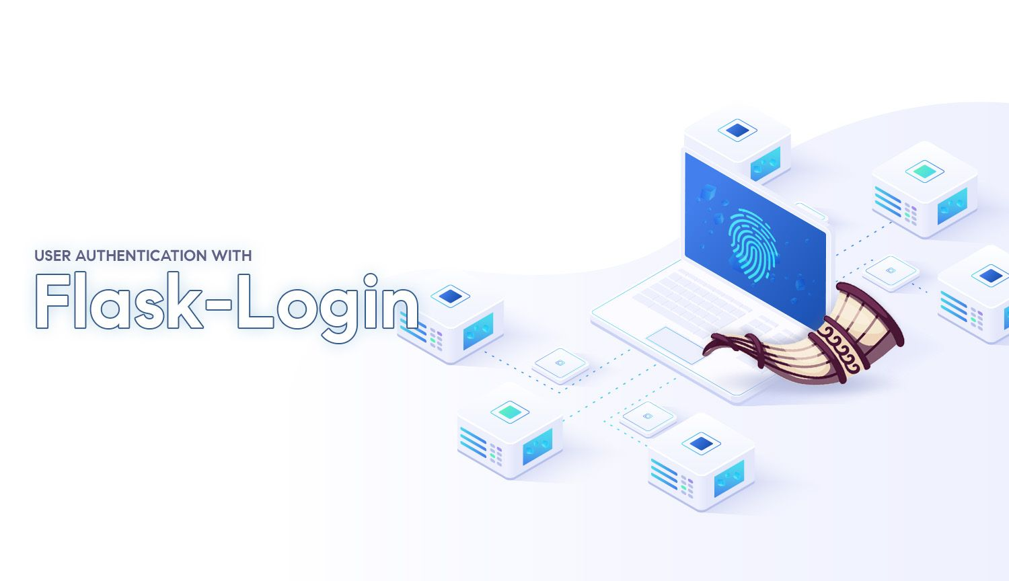
DEPENDENCIES ON LIBRARIES
KIARA ROJAS

Slide 10


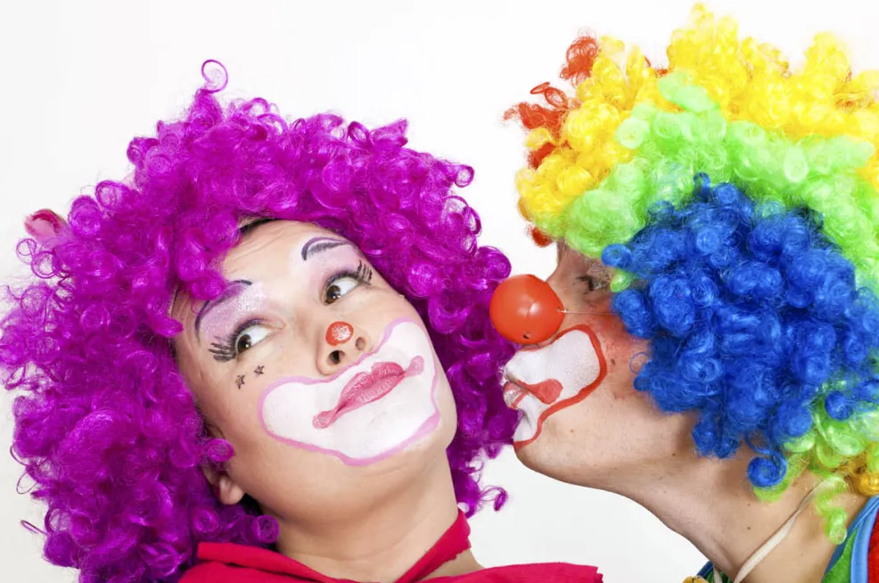
FRONTED ENHANCEMENTS
The CSS will be enhanced to fit the clown theme with colorful colors and fun fonts.
Kiara Rojas

Slide 11
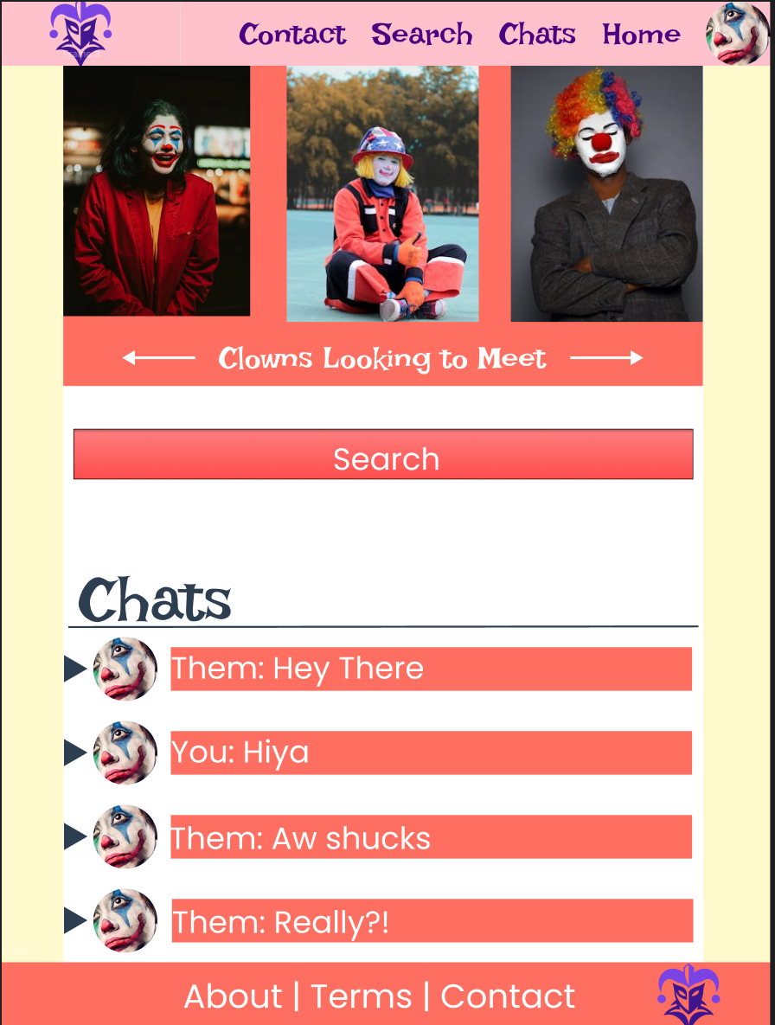
UI MarkUp
Our Goal was to create a UI that is fun, approachable, and consistent with the clown dating theme while also maintaining clear navigation, readability, and user-friendly interaction patterns.
The Color palette
It was chosen to balance vibrancy with readability. Clowns are already very colorful so softer colors were chosen to try and balance it all out
Key Features
This mockup is supposed to highlight the key features of our website and try and place them in spots that look good

Slide 12

Summary
Clowns are an underrepresented crowd in modern dating applications. Through our work, we will bring them the necessary attention and love they need.
The safe and authentic space of OnlyClowns will be beneficial and will bring about increased happiness and clown families.
Austin Rager

Slide 13

Questions?

Slide 14
Thank you!
Confidential

